Slide 1
Fundamental of the Optical Fiber

Slide 2

Contents
The following will be learned at the end of this module:
  What Is Fiber Optics?
  Fiber Advantages
  Fiber Optic Installation Safety Rules
  How Optical Fiber Is Made
  Fiber Design
  How Fiber Works
  Fiber Types
  Refraction & Reflection
  Optical Fiber Parameters
  Frequency
  Attenuation
  Scattering
  Absorption
  Dispersion

Slide 3
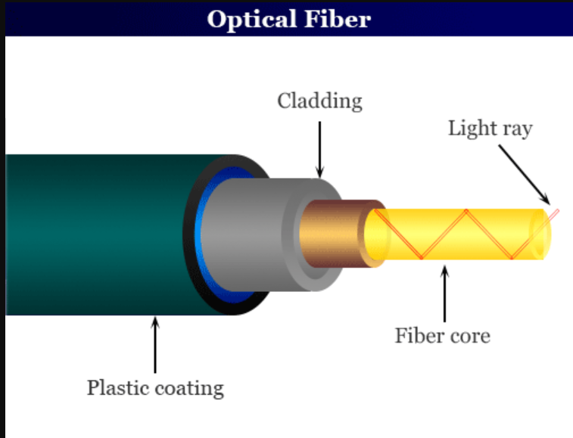
WHAT IS FIBER OPTICS?
In its simplest terms, fiber optics is the technology of using “waveguides” to transport information from one point to another in the form of light. Fiber optic communications is based on the principle that light in a glass medium can carry more information over longer distances than electrical signals can carry in a copper or coaxial medium. The purity of today's glass fiber, combined with improved system electronics, enables fiber to transmit digitized light signals well beyond 100 km (60 miles) without amplification. With few transmission losses, low interference, and high bandwidth potential, optical fiber is an ideal transmission medium Fiber.

Slide 4
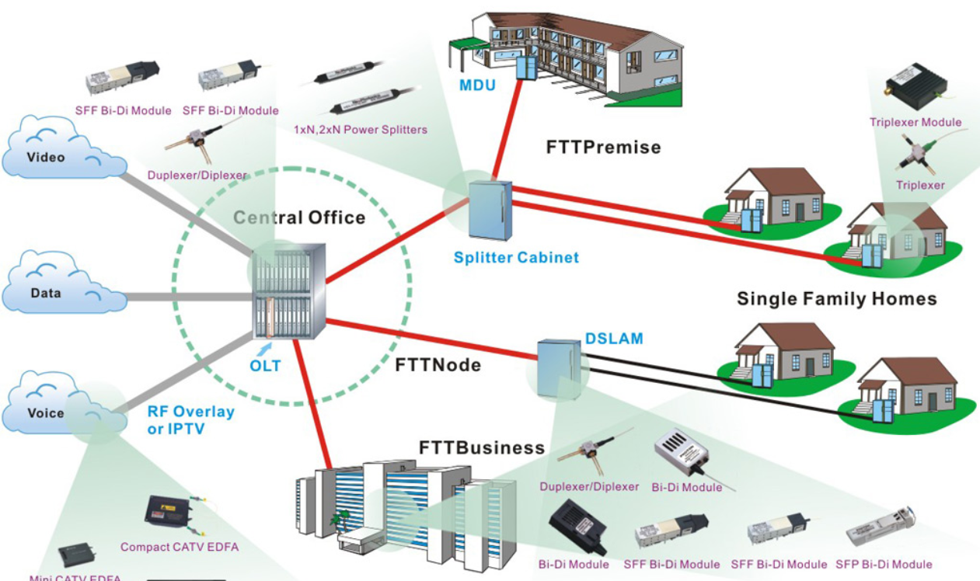
WHAT IS FIBER OPTICS?
In its simplest terms, fiber optics is the technology of using “waveguides” to transport information from one point to another in the form of light. Fiber optic communications is based on the principle that light in a glass medium can carry more information over longer distances than electrical signals can carry in a copper or coaxial medium. The purity of today's glass fiber, combined with improved system electronics, enables fiber to transmit digitized light signals well beyond 100 km (60 miles) without amplification. With few transmission losses, low interference, and high bandwidth potential, optical fiber is an ideal transmission medium Fiber.

Slide 5
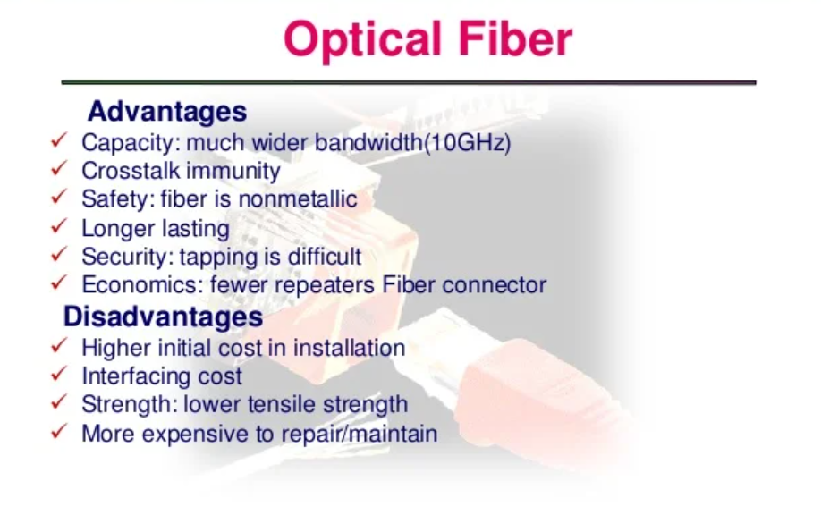

Slide 6
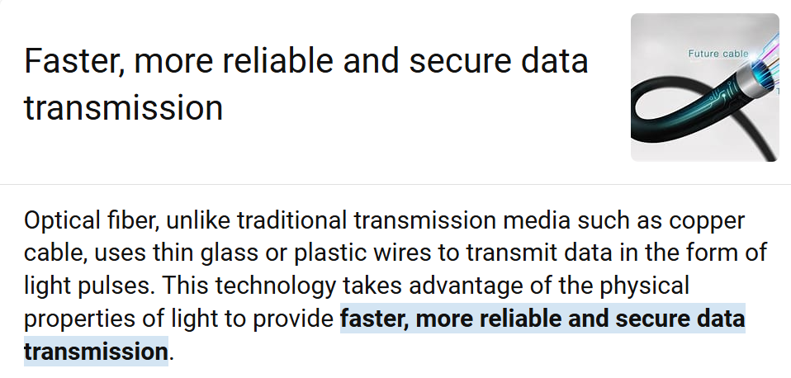
WHY FIBER OVER OTHER TRANSMISSION MEDIA

Slide 7
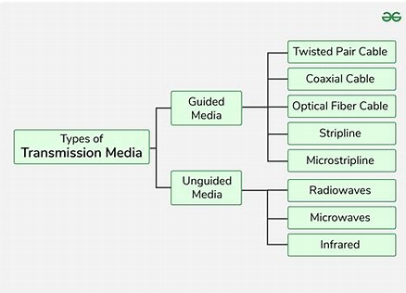
Transmission media

Slide 8
FIBER OPTIC HANDLING SAFETY RULES
1. Keep all food and beverages out of the work area. If fiber particles are ingested, they can cause internal hemorrhaging.
2. Wear aprons to minimize fiber particles getting on your clothing. Fiber particles on your clothing can later get into food, and drinks, and/or be ingested by other means.
3. Always wear safety glasses with side shields. Treat fiber optic splinters the same as you would glass splinters.
4. Never look directly at the end of fiber cables until you are positive that there is no active source at the other end. Since the light is infrared, you can't see it.
5. Before inspecting a connector with a fiber optic microscope, ensure that the fiber is not active - a microscope can increase the danger associated with high-powered light sources by focusing the light from a fiber into your eye.
6. Only work in well-ventilated areas - never splice in a manhole!
7. Contact wearers must not handle their lenses until they have thoroughly washed their hands.
8. Do not touch your eyes while working with fiber optic cables until they have been thoroughly washed.
9. Keep all combustible materials well away from the splicing area. 10. Account for all fiber shards and discard them in a safe place.
11. Thoroughly clean your work area when you are done.
12. Do not smoke while working with fiber optic systems.
13. Installation of fiber optics may require the use of chemicals that can be considered hazardous. To ensure chemicals are used properly, always consult the Material Safety Data Sheet (MSDS).

Slide 9
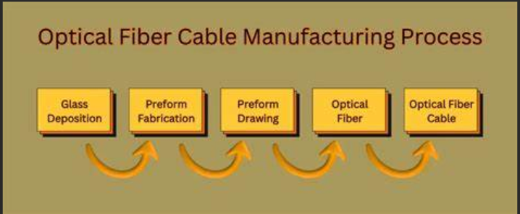
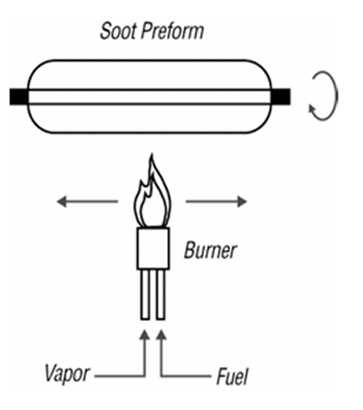
HOW OPTICAL FIBER IS MADE
There are two main steps in the process of converting raw materials into optical fiber ready to be shipped. 1. Making the preform and 2. Drawing the perform.
1. There are several methods used to make preforms. In the Modified Chemical Vapor Deposition (MCVD) process, the highly controlled mixture of chemicals described below is passed through the inside of a rotating glass tube made of pure synthetic SiO2. A hollow glass tube approximately 40 cm in length known as a "preform" is placed horizontally and rotated slowly on a lathe, and gases such as silicon tetrachloride (SiCl4) or germanium tetrachloride (GeCl4) are injected with oxygen at the end of the tube. The gases are then heated using an external hydrogen burner. As the gasses flow inside the tube, they react to the heat by forming solid submicron particles, called "soot," in the vicinity of the heat zone. Once the soot is formed, it is deposited on the inner wall of the tube. The deposited material will form the core region of the optical fiber. The process is repeated for many hours as each subsequent core layer is formed. For every sweep of the burner, the manufacturer can modify the composition, viscosity, and thickness of the deposited layer to produce specific fiber designs. After the desired amount of core material is deposited the chemical flow is eliminated, the speed of the torch is decreased, and the temperature of the flame is increased so that the tube collapses into a solid rod.

Slide 10
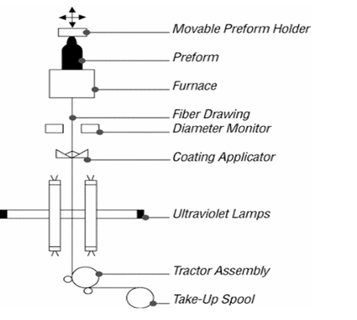
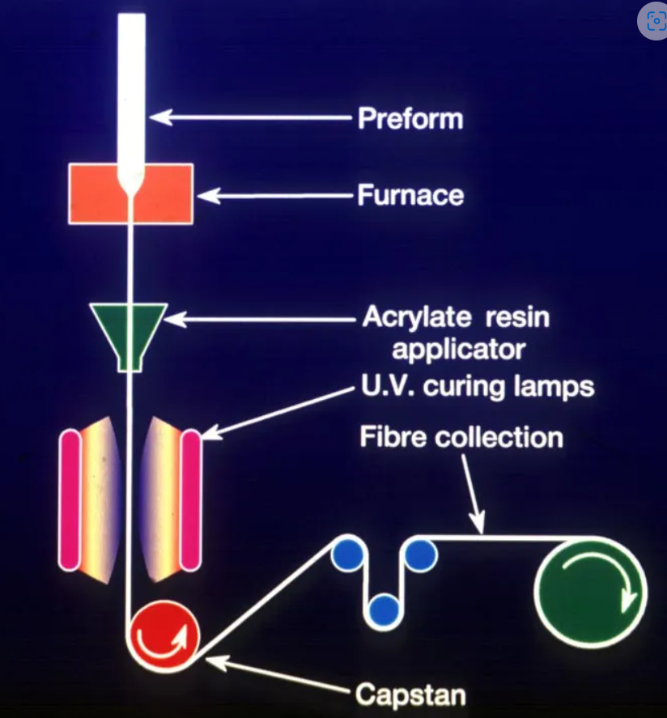
HOW OPTICAL FIBER IS MADE
2. Preform drawing. The tip of the preform is lowered into a high-purity graphite furnace. Pure gases are injected into the furnace to provide a clean and conductive atmosphere. In the furnace, tightly controlled temperatures approaching 1900°C soften the tip of the preform. Once the softening point of the preform tip is reached, gravity takes over and allows a molten gob to "free fall" until it has been stretched into a thin strand. During the draw, the preform is heated at the optimum temperature to achieve an ideal drawing tension. Draw speeds of 10 - 20 meters per second are not uncommon. The fiber goes through a precise on-line diameter monitor to ensure a specified outside diameter. Next, coatings are applied and cured, using ultraviolet lamps. At the bottom of the draw, the fiber is wound on spools.

Slide 11
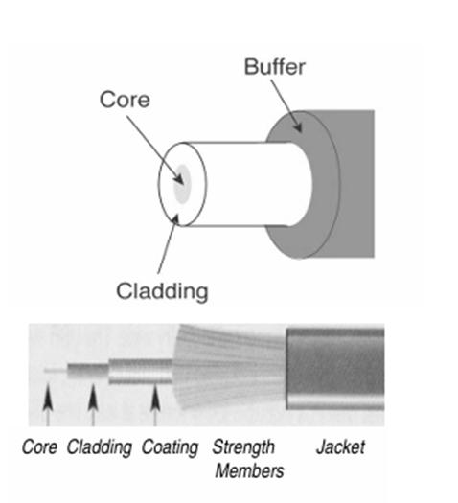
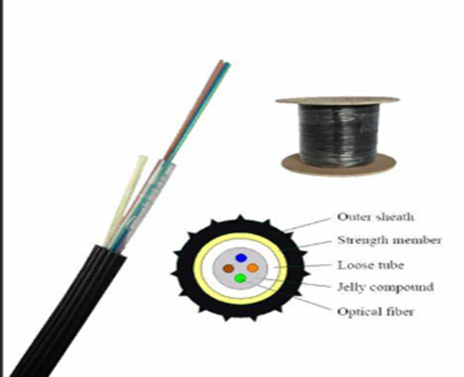
FIBER DESIGN
Core, Cladding, and Coating: An optical fiber consists of two different types of highly pure, solid glass, composed to form the core and cladding. A protective acrylate coating then surrounds the cladding. In most cases, the protective coating is a dual layer composition. Core: The light-conducting central portion of an optical fiber composed of material with a higher index of refraction than the cladding. The portion of the fiber that transmits light. Contrary to myth, the core does not have a hole in the middle but is completely solid throughout. Cladding: (Cannot be removed!) The outside optical layer of the fiber that traps the light in the core and guides it along - even through curves. Buffer coating or primary coating: Is removed during stripping. A hard plastic coating on the outside of the fiber that protects the glass from moisture or physical damage. Loose Tube = 250 microns & Tight Buffer = 900 microns. Strength members: Aramid fibers (Kevlar Kevlar®: A very strong, very light, synthetic compound developed by DuPont) which is used to pull the cable. The term is also used for the fiberglass rod in some cables used to stiffen it to prevent kink.

Slide 12
HOW FIBER WORKS
The operation of an optical fiber is based on the principle of total internal reflection. Light reflects (bounces back) or refracts (alters its direction), depending on the angle at which it strikes a surface. This reflection is usually caused by creating a higher refractive index in the core of the glass than in the surrounding cladding glass, creating a “waveguide of sorts.” The refractive index of the core is increased by marginally modifying the composition of the core glass, generally by adding small amounts of a dopant. Typical values of refractive index are 1.47 for the core and 1.46 for the cladding.
Refraction; light changes direction, but without reflecting from a surface. Reflection: light bounces off of the surface and starts traveling abruptly in a very different direction. Total Internal Reflection: The speed of light is determined by the medium in which it is traveling. The index of refraction (ir) for a material is expressed as the ratio of the speed of light in a vacuum (c) to the speed of light in the material (v), where ir = c/v. Values of ir are 1.47 for the core and 1.46 for the cladding. Light traveling across an interface from a higher refractive index medium (core) to a lower refractive index medium (cladding) will bend away from the normal. This has a pretty cool implication: at some angle, known as the critical angle c light, traveling from a higher refractive index medium to a lower refractive index medium will be refracted at 90° - along the interface. If the light hits the cladding at any angle larger than this critical angle, it will not pass through at all. Instead, it will be reflected back into the core, a process known as total internal reflection. So, light waves bend (refract) or bounce (reflect) when they meet the boundary between two materials with different indices of refraction. The angle at which the light strikes the boundary affects the amount and direction of light that is refracted or reflected. Oh, by the way, light reflected from a glass-air boundary is called a Fresnel reflection.

Slide 13
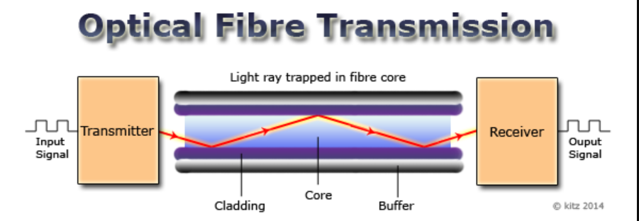

Slide 14
FIBER TYPES
The 'multi' in multi-mode comes from the fact that light
travels down the cable in multiple paths. Essentially, the
light beam is 'bounced' off the cladding as it travels down
the core. Multimode fiber has light traveling in the core in
many rays, called modes. It has a fairly large core (62.5
or 50 microns) and is used with LED sources at
wavelengths of 850 and 1300 nm for slower local area
networks (LANs).
Step index multimode was the first fiber design but is
too slow for most uses, due to the dispersion caused by
the different path lengths of the various modes. Step
index fiber is rare - only Plastic Optical Fibers (POFs)
uses a step index design today.
Graded index multimode fiber uses variations in the
composition of the glass in the core to compensate for the
different path lengths of the modes. It offers hundreds of
times more bandwidth than your step index fiber.
With Graded index MM, the refractive index of the core
gradually decreases farther from the center of the core.
The light rays traveling in the center, travel slower than
the rays on the outside.
The increased refraction in the center of the core slows
the speed of some light rays, allowing all the light rays to
reach the receiving end at approximately the same time.
The ray is continually redirected as the refractive index
changes.
.
Single-mode fiber shrinks the core down so small that
the light can only travel in one ray. This increases the
bandwidth to almost infinity.
It has a core of only about 9 microns or less. It is used for
telephony and CATV with laser sources at 1310 and 1550
nm.
While it might appear that multimode fibers have a higher
capacity because the are bigger, in fact the opposite is
true. Single-mode fibers are designed to maintain spatial
and spectral integrity of each optical signal over longer
distances, allowing more information to be transmitted.
Its tremendous information-carrying capacity and low
Intrinsic Loss have made single-mode fiber the ideal
transmission medium for longer-distance and higher
bandwidth applications. Multimode fiber is used primarily
in systems with short transmission distances of ± 2kilometers.

Slide 15
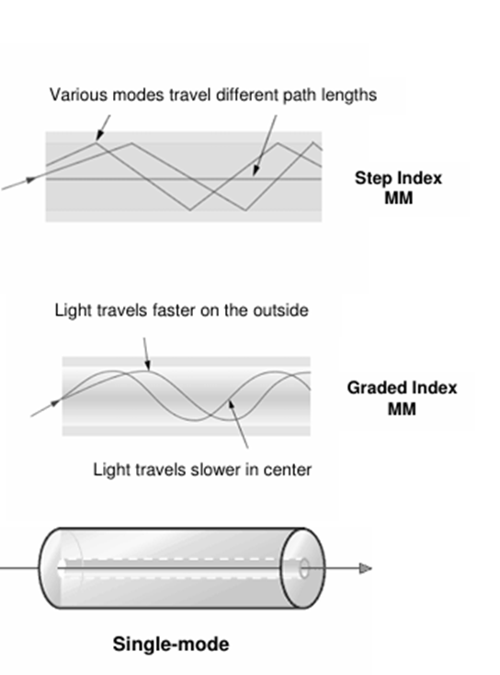

Slide 16
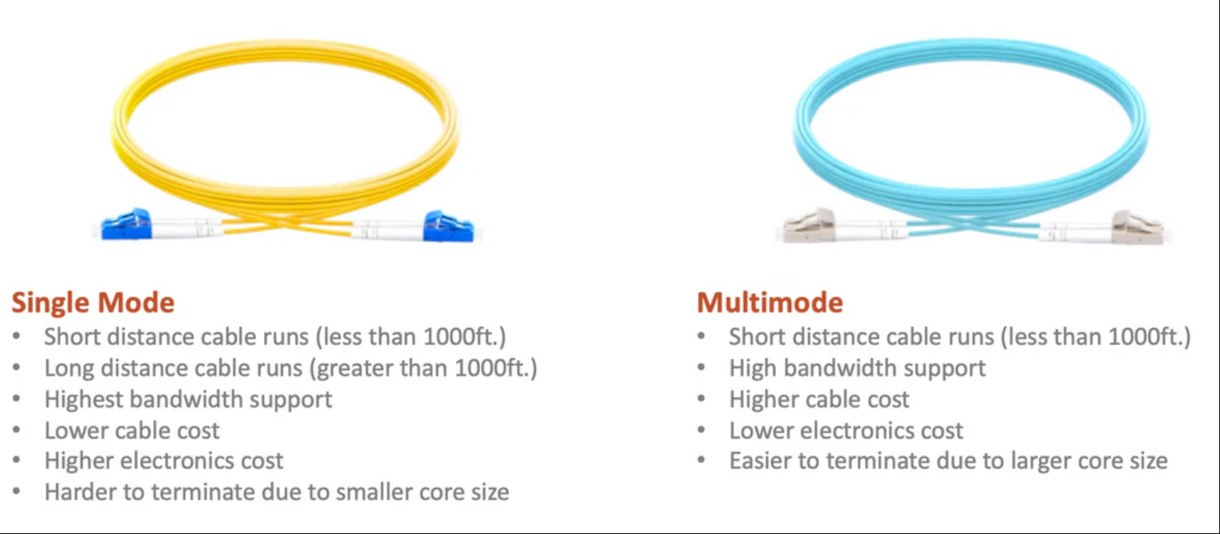
Differences between singlemode and multimode fiber optics

Slide 17
ATTENUATION
Attenuation is the reduction of signal strength or light power over the length of the light-carrying medium. Fiber attenuation is measured in decibels per kilometer (dB/km). Several different factors cause attenuation but primarily scattering and absorption.
• Rayleigh scattering is the largest cause (± 96%) of attenuation in optical fiber. It occurs when light collides with individual atoms in the glass, which knocks it off its original course.
• Absorption accounts for 3 to 5% of fiber attenuation - caused by light being absorbed by
residual materials, such as metals or water ions, within the fiber core and inner cladding. It is these water ions that cause the “water peak” region on the attenuation curve.
• Light leakage due to bending, splices, connectors, or other outside forces are other factors resulting in attenuation.
The ranges of wavelengths at which the fiber operates best are as follows: Each range is known as an operating window.
• Lasers are usually used at 1310 or 1550 nm, for single-mode applications.
• On the other hand, LEDs are used at 850 or 1300nm, making them useful for multimode fiber.

Slide 18
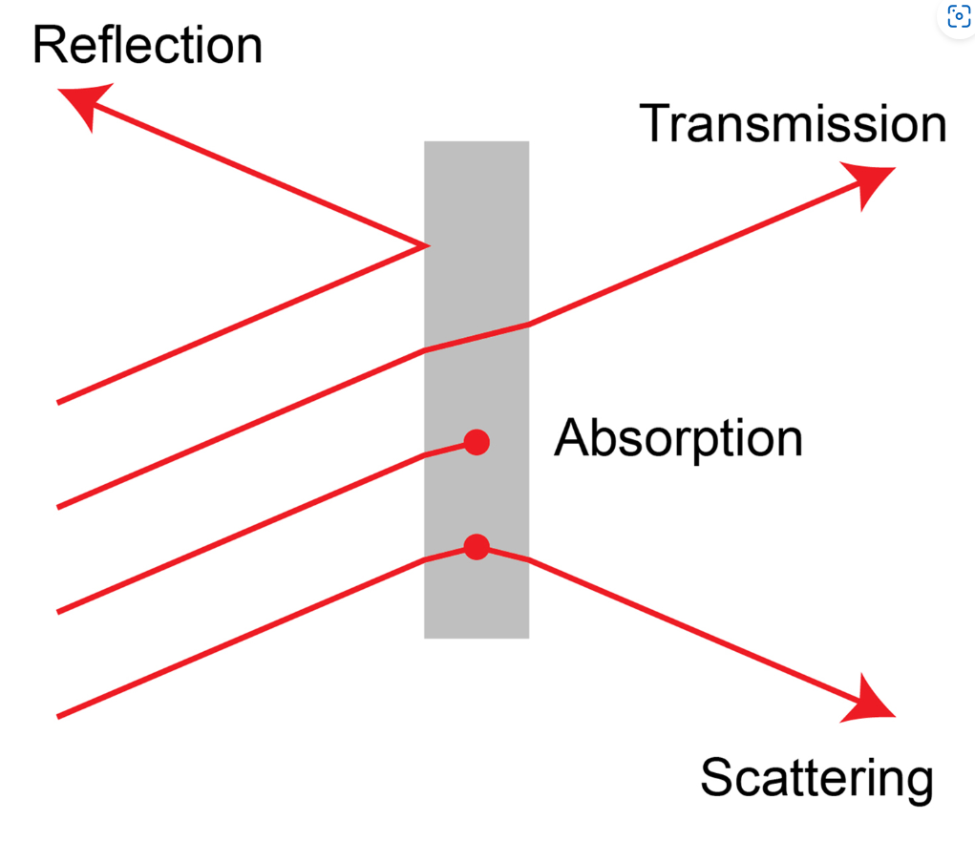
Absorption and Scattering:
Absorption is caused by materials in the glass fiber absorbing light at certain wavelengths, especially with any water left in the glass after processing.
Scattering is a much bigger problem, caused by light hitting molecules which knocks them off their original course. Scattering is much lower at longer wavelengths, so using the longest wavelengths of light to transmit signals makes sense.

Slide 19
DISPERSION
Note: Dispersion is not a loss of light; it's a distortion of the signal. Thus, dispersion and attenuation are two very different and unrelated problems: Attenuation is a loss of light, while dispersion is a distortion of the light signals. There are two types of dispersion in optical fibers:
1. Modal dispersion (pulse spreading) (Found only in multimode fibers) Have a look at the illustration of a step-index multimode fiber. You will see that the rays of light enter the fiber with different angles to the fiber axis, up to the fiber's acceptance angle (numerical aperture). Rays that enter with a shallower angle travel by a more direct approximation and arrive sooner than those enter at steeper angles (which reflect many more times off the core/cladding boundaries of the fiber). The arrival of different modes of the light at different times is called Modal Dispersion. Graded-index multimode fiber was designed to compensate for this by making the outer parts of the core a lower index of refraction than the inner parts of the core, the higher order modes speed up as they go away from the center of the core, compensating for their longer path lengths. But in real life, the index profile is a piecewise zero-zero-dispersion and all modes are not perfectly transmitted, allowing for some modal dispersion.
2. Chromatic Dispersion (Present in both multi and single-mode fibers). The sum of material dispersion and waveguide dispersion. a. Material dispersion is caused by the variation in refractive index of the glass in the fiber. b. Waveguide dispersion occurs in single-mode fiber due to the difference in the speed of the signal between the core and the cladding. Chromatic dispersion is a bigger problem with LEDs (used in multimode fiber), which have broad spectral outputs, unlike lasers that concentrate most of their light in a narrow spectral range. Chromatic dispersion occurs with LEDs because much of the power is away from the zero dispersion wavelength of the fiber. Single-mode fiber can also suffer from chromatic dispersion, as the same design and manufacturing compromises occur in optimizing single-mode fiber for transmission at a particular wavelength. Although lasers have very narrow spectral widths, single-mode fiber can also suffer disruptive chromatic dispersion over very long fiber optic runs.

Slide 20
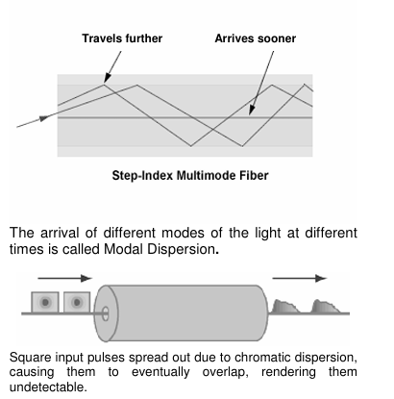

Slide 21
THANK YOU

